Slide 1
Eighth Annual Report Card Celebrating 10 Years!! Reflecting on Our Past; Focusing on Our Future

Slide 2
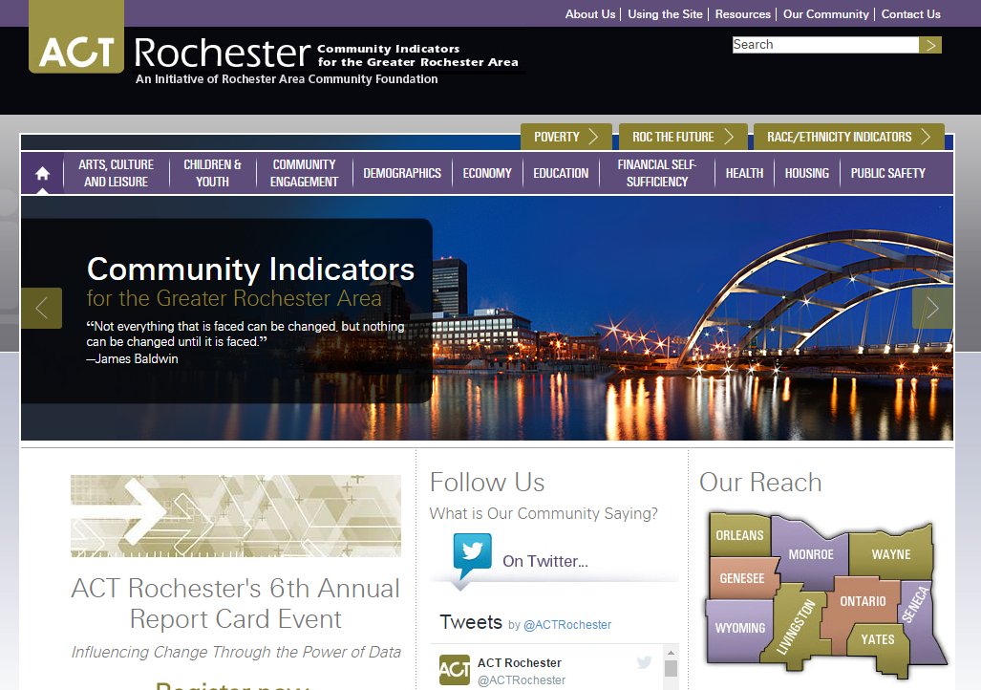
Previous ACT Rochester Homepage

Slide 3
ACT Rochester Homepage

Slide 4
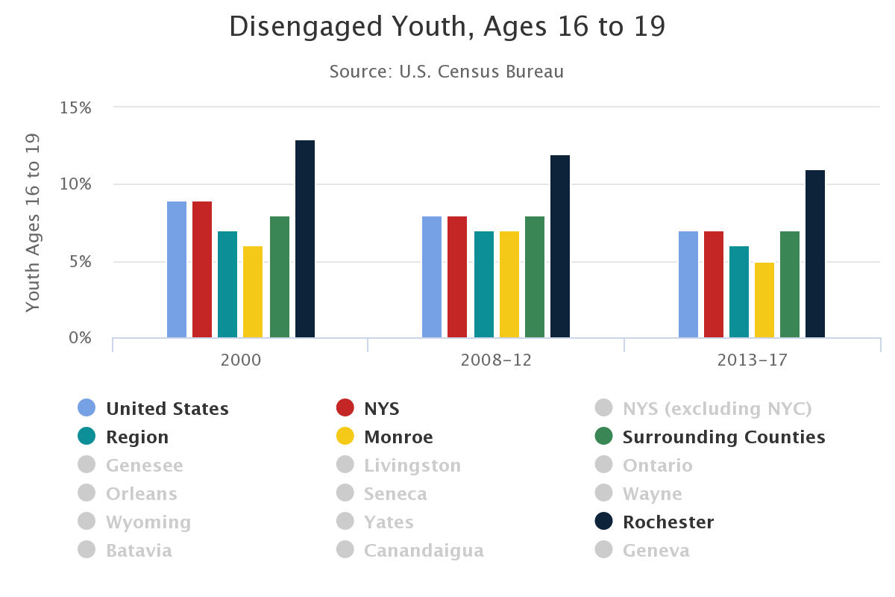
Easy-to-Use Charts

Slide 5
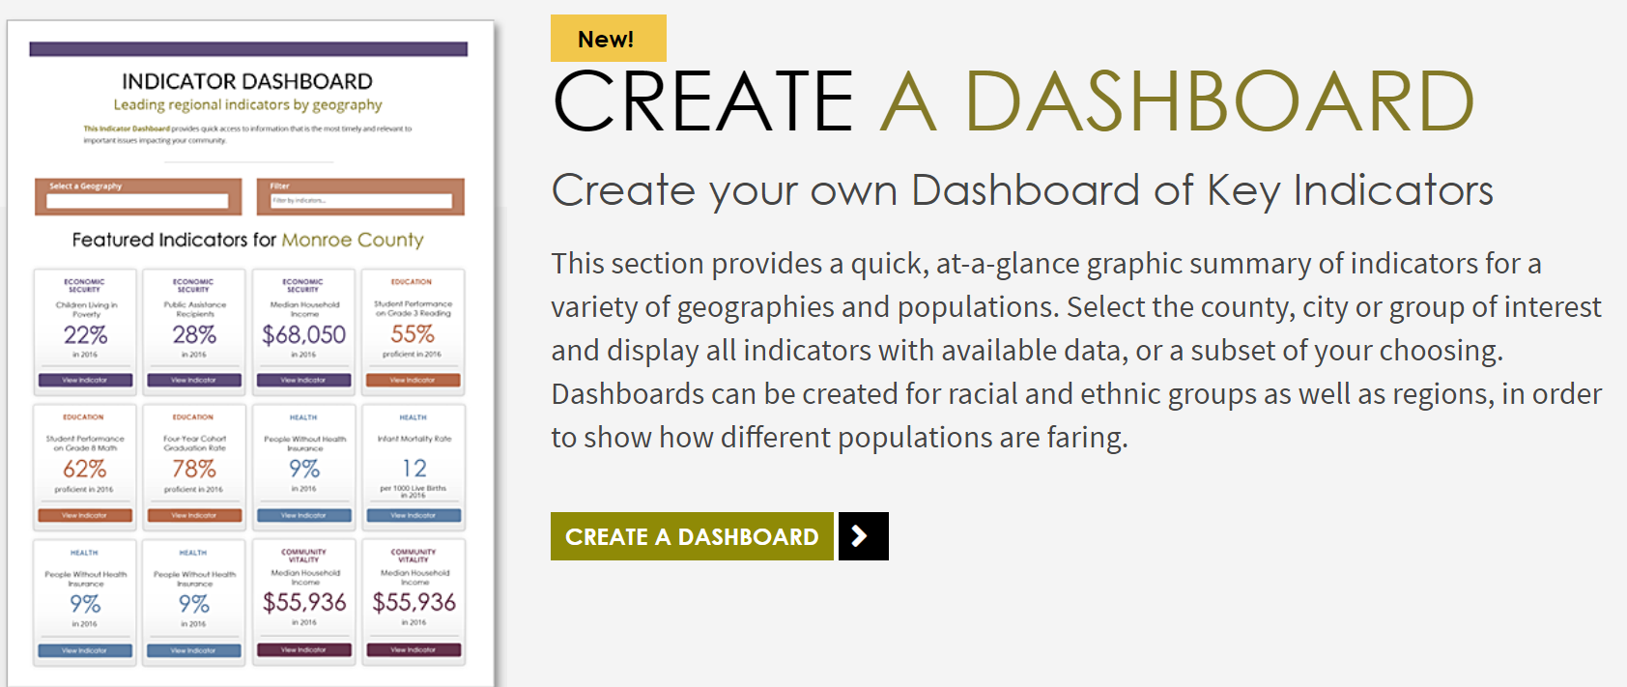
Tools to Customize Data

Slide 7
2018
2019

Slide 8
New Indicators
Children & Youth - Teen Births
Community Vitality - Households without Vehicles
Economic Security
Disengaged Youth (16-19)
Households Receiving SNAP (R/E)
Earned Income Tax Credit

Slide 9
New Indicators (con’t)
Education
Grade 3 Math (R/E)
Grade 8 Math – (new data source)
Student Performance by Subgroup
Economically Disadvantaged
English Language Learners
Students with Disabilities
Instructional Spending per Student

Slide 10
New Indicators (con’t)
Health
Supply of Doctors (new data source)
People Living with HIV, by R/E in Rochester
People Living with AIDS, by R/E in Rochester
Admissions to Substance Abuse Treatment by Primary Substance
Housing
Overall Housing Cost Burden
Vacant Housing Units
Public Safety
Incarceration Rate (R/E)
Arrest Rate (R/E)

Slide 11
Indicators Removed
Community Vitality
Attendance at Professional Sports Teams’ Home Games
Arts Teachers in Public Schools
Support of United Way and Community Foundation
Demographics - Household Type
Children & Youth
Rate of Children Receiving Public Assistance
Emergency Meals Served
Supplemental Security Income Recipients
Subsidized Child Care

Slide 12
Indicators Removed (con’t)
Economy
Change in Population of Potential Workforce by Age
Per-Capital Spending for County Government
Education
Student Performance on 4th Grade English/by Economic Background/Race and Ethnicity
Health
People Enrolled in Medicaid Manage Care
Mortality Rate from Heart Disease/Cancer/Chronic Lower Respiratory Disease/Stroke
Mental Health Clinic Visits

Slide 13
Indicators Removed (con’t)
Housing
Residential Building Permits
Non-Residential Building Permits
Temporary Housing Assistance, Monroe County
Public Safely
Property Crimes
Other Reported Crimes
Felony Drug-Related Arrests
PINS Petitions
Juvenile Delinquency Intakes
Responses to 911 Calls

Slide 14
2019 NYS County Comparisons

Slide 15
2019 County Trend Comparisons

Slide 16
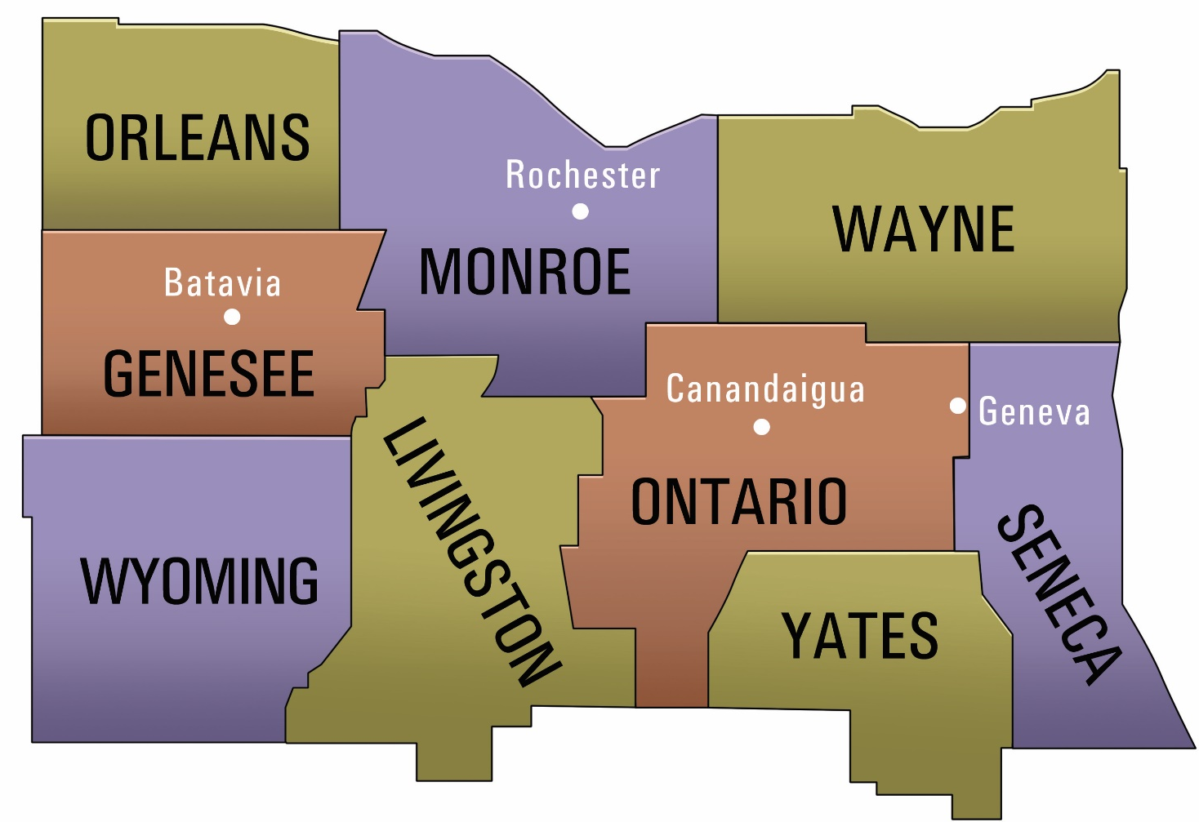
ACT Rochester’s Coverage

Slide 17
Regional City Comparison

Slide 18
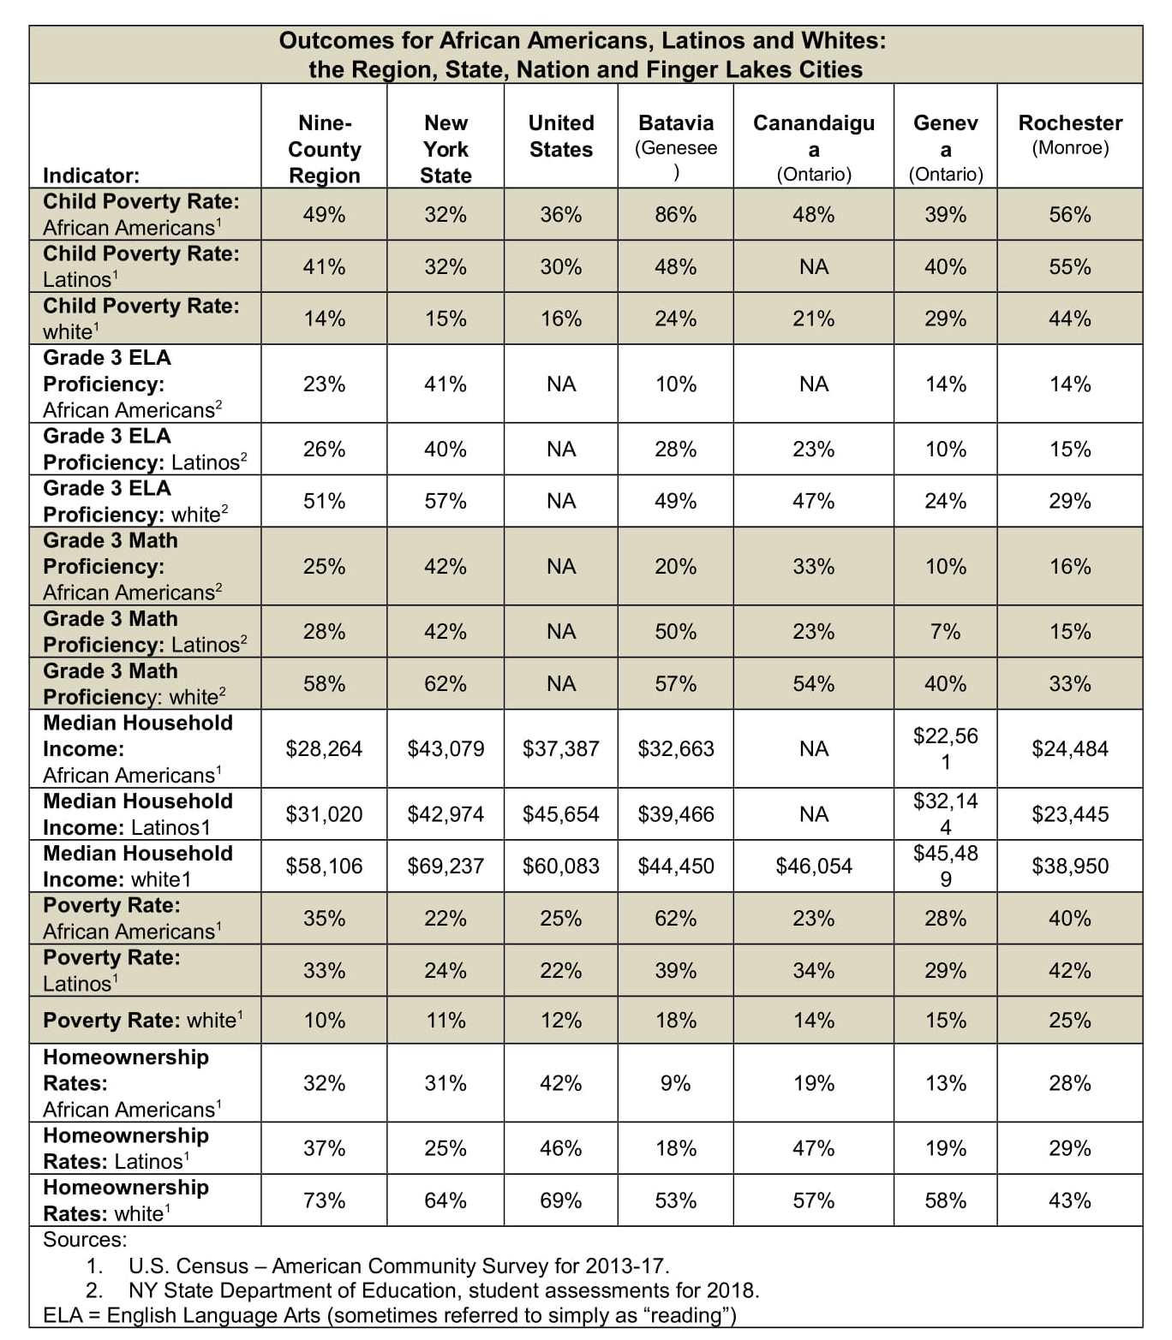
Regional Cities by Race/Ethnicity

Slide 19
Eighth Annual Report Card Celebrating 10 Years!! Reflecting on Our Past; Focusing on Our Future

